Slide 1
CMSC 426 Principles of Computer Security
Ethics and Computer Security

Slide 2
Last Class We Covered
Cryptanalytic attacks
Attack methods
Attack types
Attack types
Ciphertext only
Known plaintext
Chosen plaintext
Pseudorandom numbers

Slide 3
Any Questions from Last Time?

Slide 4
Today’s Topics
“Big” ethics questions and ideas
Case studies
Let’s Encrypt
Marcus Hutchins (WannaCry)
Hacking back
Responsible disclosure
Gray hat hacking
Apple encryption

Slide 5
Ethical Topics

Slide 6
“Big” Ethical Questions
What do “right” and “wrong” mean?
Who gets to decide what’s right and wrong?
How do/should those decisions be made?
What should we do about things that are wrong?
We won’t be answering these today!
Based on slides by Dr. Cynthia Matuszek

Slide 7
Basic Ideas of Right and Wrong
It’s wrong to harm people
Physically, emotionally, financially…
It’s wrong to discriminate against people
It’s wrong to steal from people
It’s wrong to invade people’s privacy
It’s wrong to be unfair to people
We’ll assume that these things are true…
Barring extenuating circumstances
And remembering that there’s sometimes no “right” answer
Based on slides by Dr. Cynthia Matuszek

Slide 8
Let’s Encrypt

Slide 9
Certificate Authorities
Certificate authorities charge money to issue certificates used in Transport Layer Security (TLS)
Sometimes also called Secure Sockets Layer (SSL)
Prices vary, but typically $100 or more a year
SSL/TLS certificates are used to enable secure HTTPS connections
Seems that if more websites could use HTTPS, the Web would be a safer place overall, right?

Slide 10
Let’s Encrypt
Let’s Encrypt is a CA that issues free, renewable 90-day TLS/SSL certificates for Domain Validation (DV)
Guess who took advantage of these?
In December 2015, criminals
Used issued certificates to…
Disguise malicious traffic to a website that…
Ran an exploit kit to…
Download a banking Trojan onto the user’s computer
Information taken from https://blog.trendmicro.com/trendlabs-security-intelligence/lets-encrypt-now-being-abused-by-malvertisers/

Slide 11
Revocation of Certificates
Let’s Encrypt does not revoke certificates for malicious sites
“A DV certificate […] says nothing about a site’s content or who runs it”
“Users are much better informed and protected when browsers include anti-phishing and anti-malware features”
“On a philosophical and moral level, mistakes will mean censorship, since CAs would be gatekeepers for online speech and presence”
“CAs are not well positioned to operate anti­-phishing and anti-malware operations – or to police content more generally”
“For the time being, Let’s Encrypt is going to check with the Google Safe Browsing API before issuing certificates”
Information taken from https://letsencrypt.org/2015/10/29/phishing-and-malware.html

Slide 12
Marcus Hutchins (WannaCry)

Slide 13
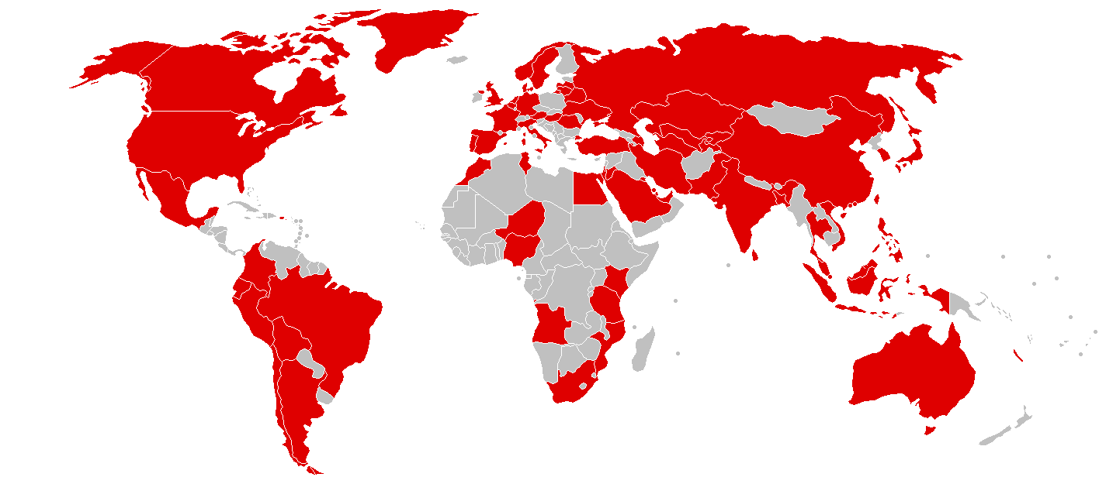
Recap on WannaCry
Propagated and spread as a worm (not a Trojan)
Uses a leaked NSA-developed exploit to propagate
Exploit called “EternalBlue,” leaked by the Shadow Brokers
Windows released a patch in March 2017
WannaCry was released worldwide in May 2017
Caused billions of dollars in losses and damages

Slide 14
Marcus’s Exploits
Authors the cybersecurity blog MalwareTech
Discovered a “kill switch” for WannaCry after it struck in 2017
Code in WannaCry was linked to an unregistered domain name
Marcus registered it, and this stopped the worm from spreading
Alleged to have created the Kronos malware in 2014
Kronos was sold via a darknet market for $7,000 in 2015
How should past and current actions be weighed?
Information taken from https://krebsonsecurity.com/2017/09/who-is-marcus-hutchins/

Slide 15
Hacking Back

Slide 16
What is “Hacking Back”?
Essentially, “attacking back” the computers/people that are currently or recently attacked a person or company
Measures taken within the boundaries of one’s own network are not normally counted as hacking back
Monitoring traffic patterns, encrypting data, using authentication
Natural to want to “defend” yourself
Especially since law enforcement can’t/won’t help with malware
“Pay the ransom” is common advice
Information taken from http://www.slate.com/articles/technology/future_tense/2017/10/hacking_back_the_worst_idea_in_cybersecurity_rises_again.html

Slide 17
ACDC Legislation
Stands for Active Cyber Defense Certainty Act
Introduced to House, referred to subcommittee in November 2017
Would grant authorized entities the legal authority to venture outside their computer networks to
Establish attribution (i.e., nature, cause, source) of an attack
Disrupt cyberattacks (without damaging other computer systems)
Retrieve and destroy any files stolen during the course of an attack
Monitor the behavior of an attacker
Use “beaconing” technology
Information taken from https://www.cyberisk.biz/active-cyber-defense-certainty-act/

Slide 18
ACDC Legislation Breakdown
“Only allows retaliatory action against computers based in U.S. territory”
Does this present any problems or limitations?
Establish attribution (i.e., nature, cause, source) of an attack
How easy and/or accurate is it to do this?
Disrupt cyberattacks (without damaging other computer systems)
How to prevent collateral damage caught in the crossfire?
Retrieve and destroy any files stolen during the course of an attack
May taint forensic evidence at the scene of an attack
Use “beaconing” technology
How is this meaningfully different from “creepware”?
Information taken from https://www.cyberisk.biz/active-cyber-defense-certainty-act/

Slide 19
Responsible Disclosure

Slide 20
Vulnerability Disclosure
When white hat hackers or security researchers discover a vulnerability, what responsibilities do they have?
Disclose the issue to the public so they know about it
“The public has a right to know”
Forces the vendor to address the issue
Alert the vendor of the issue so they can fix it
But then the vendor is getting free security consultations
Is it ethical to expect/demand payment?
Some vendors offer “bug bounties” to incentivize detection and reporting

Slide 21
Responsible Disclosure
Compromise between alerting the public and alerting the vendor
Vendor is alerted first, and is given a period of time in which to fix and/or patch the vulnerability
Time that is granted is often negotiated, and depends on the possible impact, difficulty of fixing the issue, etc.
After this time period, the vulnerability is released to the public
Including people who would take advantage of it

Slide 22
Google’s Project Zero
Project Zero is a full-time team dedicated to find zero-day vulnerabilities, including in non-Google products
Vulnerability is released after patch, or after a strict 90 days
To help with patching, a Proof of Concept is often provided to vendor
Disclosed a Windows vulnerability two days before patch released
Patch was already scheduled for “Patch Tuesday”
Google released the PoC in code and executable form
Windows is one of Google’s competitors
“Don’t use vulnerable software” doesn’t work for things like the Windows OS
Information taken from https://papers.ssrn.com/sol3/papers.cfm?abstract_id=2624411

Slide 23
Gray Hat Hacking

Slide 24
Mirai and Hajime Worms
Mirai worm infects networked devices to added them to a botnet
Very widespread, infects things like routers and surveillance cameras
Hajime is a more advanced worm in how it spreads, how it hides itself, and in how difficult it is to combat
Blocks access to ports 23, 5358, 5555, and 7547
Fetches and displays a statement on the terminal
Once infected, a system is…
secured against Mirai infections
Information taken from https://papers.ssrn.com/sol3/papers.cfm?abstract_id=2624411

Slide 25
Analyzing Hajime Worm
Spreads itself onto computers without permission
Author can open a shell script to any infected machine in the network at any time
Hides its processes and files from the system
Blocks access to ports
Closes ports vulnerable to the Mirai worm
Doesn’t perform DDoS or similar attacks (but could)

Slide 26
Apple Encryption

Slide 27
Background: San Bernardino Attack
December 2015, a married couple perpetrated a terrorist attack consisting of a mass shooting and an attempted bombing
Terrorists were killed in a shootout with the police
Personal phones were destroyed
FBI recovered an iPhone used for work by one of the terrorists
Employee of San Bernardino, so phone actually owned by county
Unable to unlock the phone – would wipe data after 10 attempts
Requested help for NSA – unable to crack the phone
Information taken from https://en.wikipedia.org/wiki/2015_San_Bernardino_attack

Slide 28
Backdoor to Apple Security
FBI requested Apple create software that would allow them to
Attempt multiple passwords with no added delay
Prevent the automatic deletion of data
Apple declined, citing its policy to never undermine the security features of its products
FBI appealed: Apple could install the software in person, FBI would remote hack, then Apple could remove/destroy software
Request withdrawn after FBI paid a third party over 1 million dollars for use of a tool to bypass the ten-try limit
Information taken from https://en.wikipedia.org/wiki/FBI–Apple_encryption_dispute

Slide 29
Announcements
Lab 3 will come out either Friday or Saturday
Honestly, depends on if I have jury duty tomorrow
HW 3 will also come out soon
HW1 is being graded, HW2 and Lab 2 will be graded following
Also working on getting Paper 1 (and Paper 2&3) graded

Slide 30
Image Sources
White hat:
https://pixabay.com/en/hat-white-fashion-male-man-308778/
Black hat:
https://pixabay.com/en/fedora-hat-black-headwear-297371/
Gray hat (adapted from):
https://pixabay.com/en/hat-red-fashion-male-man-308779/

